Slide 1
Interactive Business Dashboard using Power BI
By:
THENMOZHI.P
DATA ANALYST INTERN AT ELEVATE LABS

Slide 2
Objective
In this Power BI dashboard project, an interactive visual report was created for business stakeholders focusing on key performance indicators such as Sales, Profit, and Growth. The dashboard includes slicers and filters for interactivity, time-series analysis to track trends over the years, and cards to display total values and summaries. A consistent color theme enhances visual clarity, and a basic navigation structure improves user experience. This dashboard is designed to support informed, data-driven decision-making.

Slide 3
Tools Used
Power BI Desktop (for dashboard design & data modelling)
Excel (as data source)

Slide 4
Key Features Implemented
Key KPIs: Sales, Profit, Growth
Time-series charts for trends
Slicers/filters for interactivity (Country, Product Line, Deal Size)
Cards for summary metrics

Slide 5
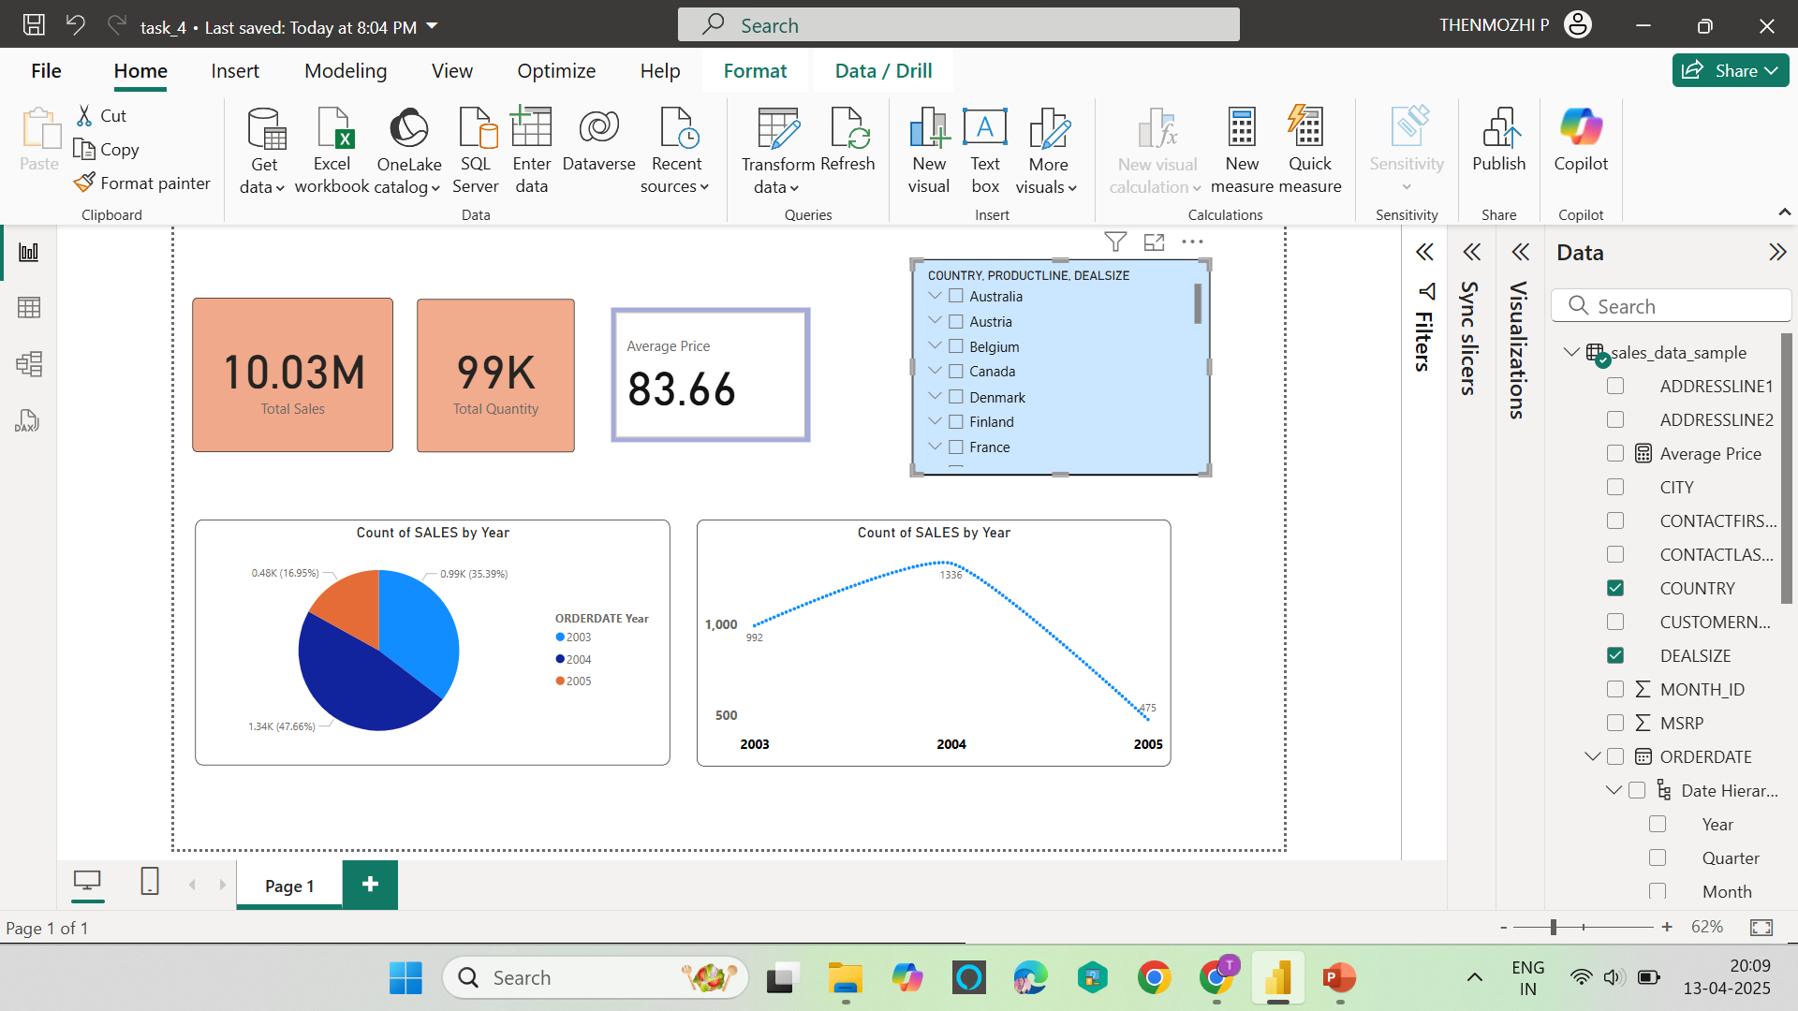
Dashboard

Slide 6
Conclusion
This Power BI dashboard presents key business insights using KPIs like Sales, Profit, and Growth. Interactive slicers and filters allow users to explore the data dynamically. Time-series analysis highlights sales trends over the years. Summary cards display total sales, average cost, and quantity for quick reference. A clean color theme and structured layout enhance user understanding and navigation.

Slide 7
THANK YOU

